Slide 1
Conference Ranking for NLP

Slide 2
NLP会议1
CCF | 简称 | 截稿日期 | 通知日期 | 会议日期
A | ACL 2018 | 2018-02-22 | 2018-04-20 | 2018-07-15
 | NAACL HLT 2018 | 已过
B | COLING 2018 | 2018-03-16 | 2018-05-17 | 2018-08-22
B | EMNLP | 2018-05-22 | 2018-08-06 | 2018-10-31
* | CICLing 2018 | 已过
* | IJCNLP | 已过
C | IJCNN 2018 | 2018-01-15 | 2018-03-15 | 2018-07-08

Slide 3
NLP会议2
CCF | 简称 | 截稿日期 | 通知日期 | 会议日期
C | NAACL 2018 | 2017-12-15 | 2018-02-13 | 2018-06-01
C | CoNLL | 2017-4-23 | 2017-5-29 | 2017-8-3
* | IALP(IEEE)
* | CLSW 汉语词汇语义学研讨会
* | CCIR 全国信息检索学术会议
* | CCL

Slide 4
AI会议
CCF | 简称 | 截稿日期 | 通知日期 | 会议日期
A | IJCAI 2018 | 2018-01-31 | 2018-04-16 | 2018-07-13
A | AAAI 2018 | 2017-09-08 | 2017-11-09 | 2018-02-02
A | NIPS 2018 | 2018-05-31 |  | 2018-12-03
A | ICML 2018 | 2018-02-09 |  | 2018-07-10
A | KDD 2018 | 2018-02-11 | 2018-05-06 | 2018-08-19
* | MLDM 2018 | 2018-01-15 | 2018-03-18 | 2018-07-14
B | BIBM | 2017-08-01 | 2017-09-20 | 2017-11-13
Notes:
MLDM 2018#International Conference on Machine Learning and Data Mining

Slide 5


Slide 6


Slide 7
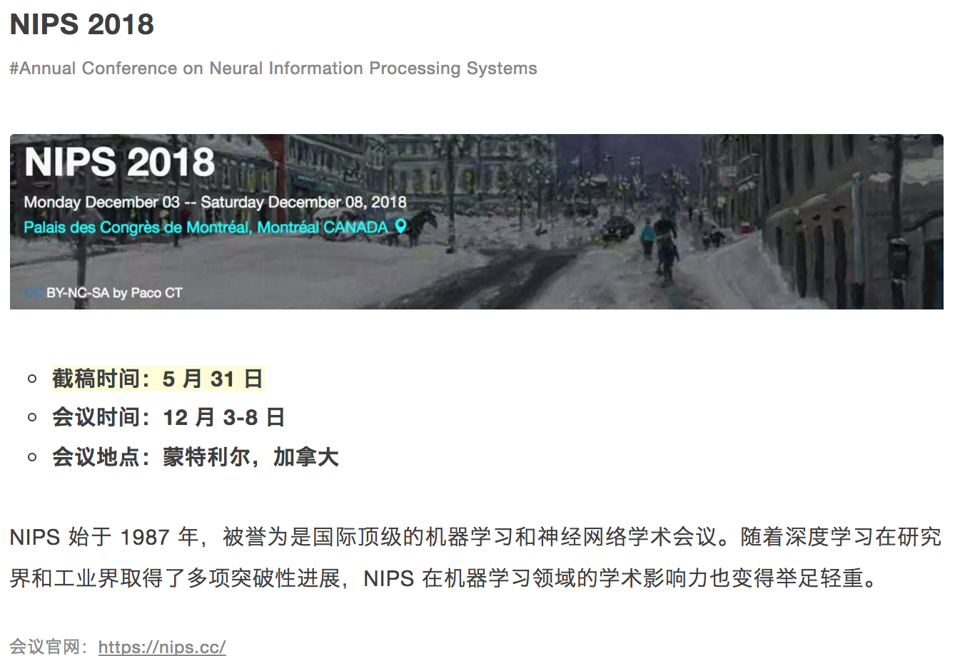

Slide 8


Slide 9


Slide 10


Slide 11


Slide 12
生物医学相关杂志
简称 | 影响因子 | ISSN
Bioinformatics | 7.307 | 1545-5963
BMC Bioinformatics | 2.75 | 1471-2105
PLoS Computational Biology | * | 1553-734X
Computers in Biology and Medicine | 1.521 | 0010-4825
Journal of Theoretical Biology | 2.113 | SCI
IEEE/ACM Transactions on Computational Biology and Bioinformatics | 1.609 | 1545-5963
IEEE Transactions on Information Technology in Biomedicine | 1.676

Slide 13
Thank you!

